Slide 1

Early Detection of Alzheimer's Disease Through Pattern Recognition
Name | ID
Sazid Hasan Tonmoy | 23241037
Nowrin Tasnim Moon | 23266010
Afreen Rahman Tithi | 18101303
ST: Mehnaz Ara Fazal
RA: Sania Azhmee Bhuiyan
Group: 02

Slide 2
Data Collection & Preprocessing
Data Acquisition
Utilized the Preprocessed Alzheimer's MRI dataset
Resized images to a uniform 224x224 pixels
Normalized pixel values to [0, 1]
Applied specific preprocessing for each model type (flattening, reshaping)
Image Resizing
Utilized OpenCV for uniform resizing of images to 224x224 pixels
Normalization
Standardized pixel values to a range of [0, 1] for consistent input
Skull Stripping
Applied skull stripping during preprocessing to enhance image quality and isolate relevant brain structures
Data Augmentation (for CNN)
Applied shear, zoom, and horizontal flip techniques to enhance CNN training set diversity

Slide 3
Data Collection & Preprocessing
Flattening (for Random Forest and SVM)
Flattened images into one-dimensional arrays for compatibility with Random Forests and SVM models
Reshaping (for LSTM and BiLSTM)
Reshaped sequences to meet the input requirements of LSTM and BiLSTM Architectures
Dataset Combination
Combined data from various dementia stages into a unified dataset, ensuring diversity, and introduced shuffling for improved model training robustness

Slide 4
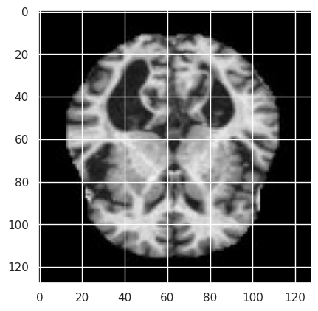
Data Collection & Preprocessing
Fig: Sample MRI Image of Mild Dementia Class

Slide 5
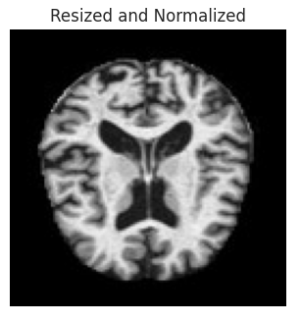
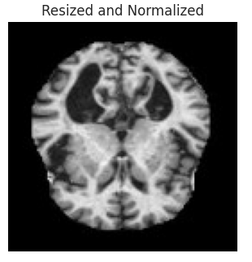
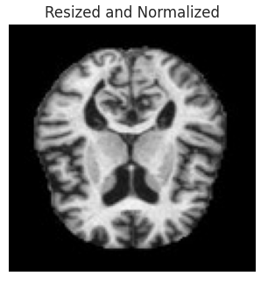
Data Collection & Preprocessing
Fig: Resized and Normalized MRI Images of Mild Dementia Class

Slide 6
Methodology
Model Training and Evaluation:
Employed machine learning models:
Random Forests
Support Vector Machines (SVM)
Convolutional Neural Networks (CNN)
Long Short-Term Memory Networks (LSTM)
Bidirectional LSTM (BiLSTM)
Split dataset into training and testing sets
Applied Data Augmentation for CNN training
Configured early stopping to prevent overfitting during CNN training
Performance Evaluation:
Assessed model performance using standard metrics:
Precision
Recall
F1-Score
Confusion matrices with Heatmaps for visualization

Slide 7
Methodology: Traditional Algorithm
Random Forest
Algorithm: Random Forest Classifier
Hyperparameters:
n_estimators: 100
random_state: 42
Support Vector Machine (SVM)
Algorithm: Support Vector Machine (SVM)
Hyperparameters:
kernel: linear
C: 1

Slide 8
Methodology: Convolutional Neural Network (CNN)
Architecture:
Convolutional Layer 1:
Filters: 32
Kernel Size: (3, 3)
Activation: 'relu'
MaxPooling Layer 1:
Pool Size: (2, 2)
Convolutional Layer 2:
Filters: 64
Kernel Size: (3, 3)
Activation: 'relu'
MaxPooling Layer 2:
Pool Size: (2, 2)
Convolutional Layer 3:
Filters: 64
Kernel Size: (3, 3)
Activation: 'relu'
Flatten Layer
Dense Layer:
Neurons: 64
Activation: 'relu'
Output Layer:
Neurons: 3 (for classification)
Activation: 'softmax'
Compilation:
Optimizer: 'adam'
Loss: 'sparse_categorical_crossentropy'

Slide 9
Methodology: BiLSTM & LSTM
Algorithm: Bidirectional Long Short-Term Memory (BiLSTM)
Architecture:
BiLSTM Layer 1:
Units: 64
BiLSTM Layer 2:
Units: 64
Dense Output Layer:
Neurons: 3 (for classification)
Activation: 'softmax'
Compilation:
Optimizer: 'adam'
Loss: 'sparse_categorical_crossentropy'
Algorithm: Long Short-Term Memory (LSTM)
Architecture:
LSTM Layer:
Units: 64
Dense Output Layer:
Neurons: 3 (for classification)
Activation: 'softmax'
Compilation:
Optimizer: 'adam'
Loss: 'sparse_categorical_crossentropy'

Slide 10
Experimental Setup
Hardware Configuration
Processor: Intel Core i7-6700k
Ram: 3200 MHz 16 GB RAM
GPU: GTX 1660 Ti
Storage: 2TB WD Blue 7200rpm HDD
Operating System: Windows 10 Pro
Software Environment
Kaggle platform
Language: Python
GPU Accelerator: T4x2 Configuration
GPU acceleration significantly reduced training time for DL models
Experimental Focus
Comprehensive experimentation for the early detection of Alzheimer's disease through pattern recognition
Thorough investigation of various machine learning and deep learning models

Slide 11
Result Analysis
The Random Forest classifier achieved an accuracy of 92%, with detailed metrics like precision, recall, and F1-score providing insights into its performance.
The SVM model exhibited outstanding performance with an accuracy of 99%, showcasing its ability to distinguish between different disease stages. Evaluation metrics, confusion matrix, and heatmap further validated its robustness.
CNN, BiLSTM and LSTM models achieved competitive accuracies and currently tuning the hyper-parameters to optimize their performance

Slide 12
Result Analysis
Table 01: Random Forest Classification Report
 | Precision | Recall | F1-Score | Support
Non-Demented | 0.91 | 1.00 | 0.95 | 643
Mild Dementia | 1.00 | 0.72 | 0.83 | 201
Moderate Dementia | 1.00 | 1.00 | 1.00 | 6
Very Mild Dementia | 0.91 | 0.90 | 0.91 | 430
Accuracy |  |  | 0.92 | 1280
Macro Avg | 0.96 | 0.90 | 0.92 | 1280
Weighted Avg | 0.93 | 0.92 | 0.92 | 1280

Slide 13
Result Analysis
Table 02: SVM Classification Report
 | Precision | Recall | F1-Score | Support
Non-Demented | 0.98 | 1.00 | 0.99 | 643
Mild Dementia | 1.00 | 0.99 | 0.99 | 201
Moderate Dementia | 1.00 | 1.00 | 1.00 | 6
Very Mild Dementia | 0.99 | 0.97 | 0.98 | 430
Accuracy |  |  | 0.99 | 1280
Macro Avg | 0.99 | 0.99 | 0.99 | 1280
Weighted Avg | 0.99 | 0.99 | 0.99 | 1280

Slide 14
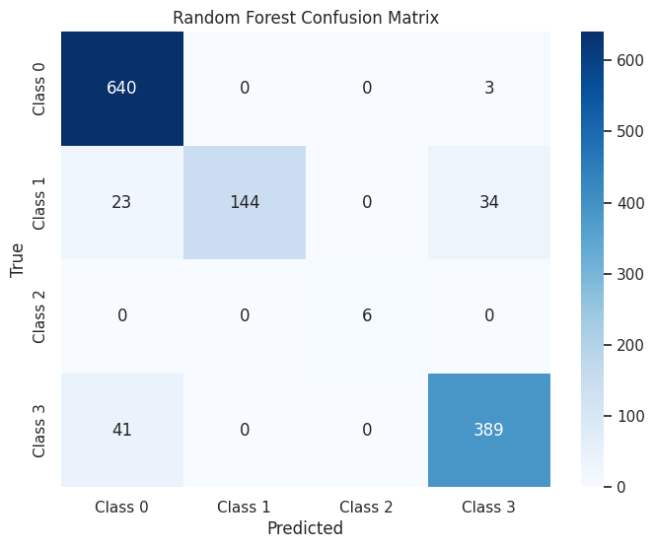
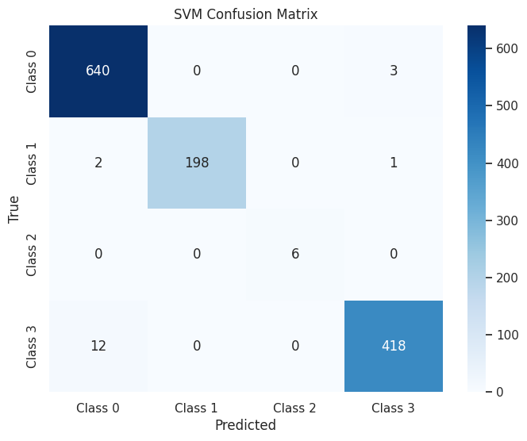
Result Analysis
Fig: Confusion Matrix Heatmap of RF & SVM Respectively

Slide 15
Conclusion
Current Progression:
Commendable results achieved with Random Forest and SVM models for early Alzheimer's detection
Performance aligns with state-of-the-art benchmarks
CNN, BiLSTM, and LSTM models need further tuning to realize their full potential
Remaining & Future Work:
Immediate focus on fine-tuning deep learning models
Exploration of ensemble methods for enhanced accuracy
Further optimization through experimenting with model architectures and integrating domain-specific features or multimodal data sources

Slide 16
Thank You

